Slide 1
2019 Joint Accounting Conference
Defined Contribution Plans - Creating, Complying and Campaigning the Plans
May 17, 2019
By: John Powell

Slide 2


Worthless
No Value
Does Not Work
Priceless
Valuable
It Works – Very Well

Slide 3
2019 Joint Accounting Conference
Defined Contribution Plans - Creating, Complying and Campaigning the Plans

Slide 4
DISCLAIMER
I am not giving financial advice. This presentation is to educate the audience about the current trends of Defined Contribution Plans.
Past Performance is No guarantee of Future Results.

Slide 5
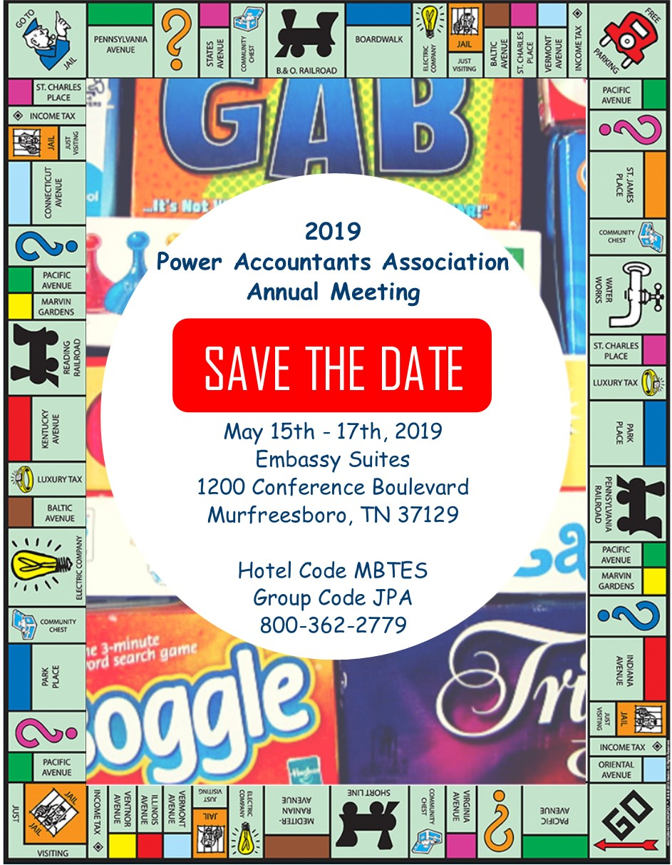
How many electric utilities are on the board?

Slide 6
PRESENTATION RULES
This is not to suggest a 401k plan instead of a Pension Plan, but in addition to a Pension Plan.
401(k), 403(b), 457, SIMPLE IRA are all Defined Contribution Plans. Please allow me to use 401(k) for the term today to describe all Defined Contribution Plans.

Slide 7
The REAL Purpose of the DB/DC Plan
Employers use Pensions and 401k plans to (a) recruit talent and (b) assist employees to prepare for retirement. To save for retirement with larger returns and tax preference treatment. They are not required by law.
I suggest it is incumbent upon us Finance and HR managers to not just get our employees TO retirement but THROUGH retirement.
The employees need someone in their company to champion the cause to lead and educate in this arena.

Slide 8
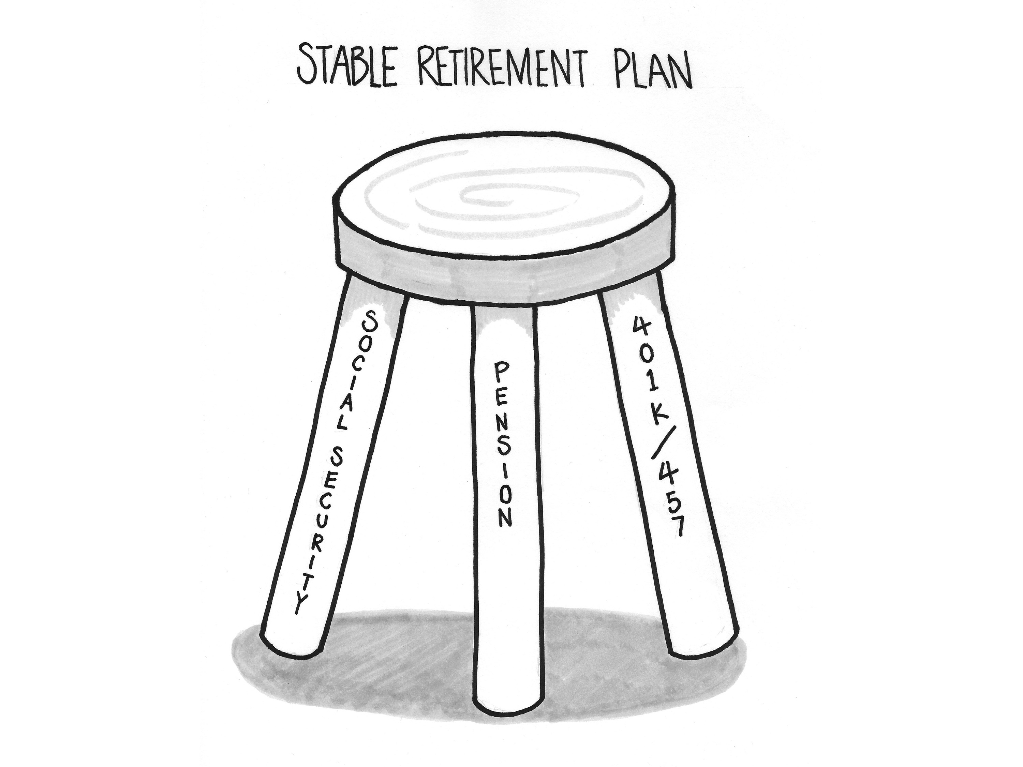

Slide 9
Assume that you must replace salary of $50,000

Slide 10
Just the Facts
False Confidence = having a pension plan and social security and thinking you have plenty of money for retirement.
If you choose a death benefit / spousal benefit for your pension, you need more money.
If you elect Social Security at 62, you need more money.

Slide 11
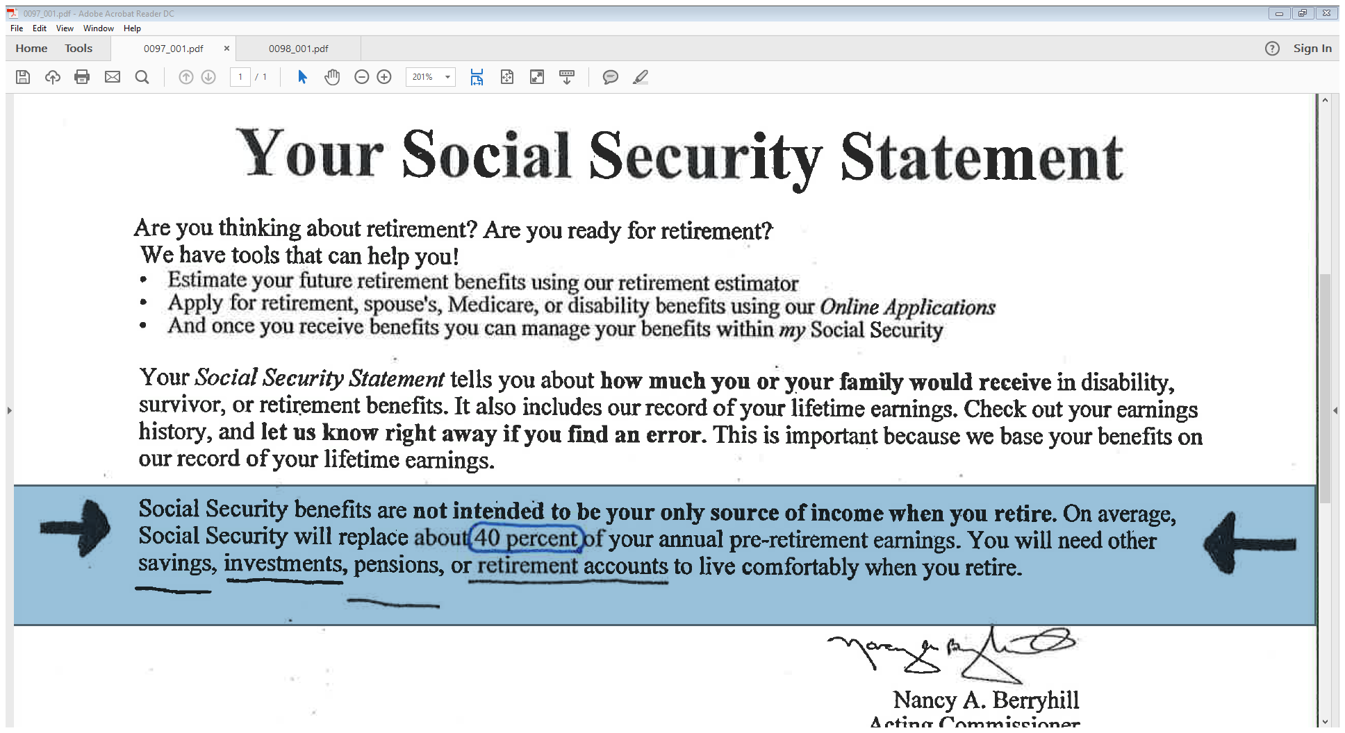

Slide 12
The effects of Inflation during Retirement
Social Security COLA adjustment for the past 10 years (2010) have been ---- 0.00 , 0.00 , 3.60 , 1.70 , 1.50 , 1.70 , 0.00 , 0.30, 2.00, 2.80 (2019) an average of 1.36%
* Alabama Pension (RSA) does not have a COLA allowance
* Mississippi and Tennessee have a minimum of 3% COLA
A 24 year retirement plan will be diluted by inflation.
You need a 401(k) plan or IRA to combat Inflation.

Slide 13
Accounting Treatment of 401(k) Plans
Pensions (DB Plans) are recorded on your balance sheet
1. The unfunded pension liability
2. Deferred inflows / outflows
401(k) Plans (DC Plans) are NOT recorded on your balance sheet. The balance belongs to the employees.

Slide 14
What is name of the place on the board that describes the effects of taking money out of the 401k plan?

Slide 15
COMPLIANCE of 401(k) Plans
E mployee
R etirement
I ncome
S ecurity
A ct
The act of 1974 is a federal law that sets minimum standards for most voluntarily established retirement plans in private industry to provide protection for individuals in these plans.

Slide 16
COMPLIANCE of 401(k) Plans
Remember that you, the employer, are responsible for keeping your plan in compliance.
Your plan document must be written to comply with all requirements in the Internal Revenue Code.
Your plan must be administered to follow its terms in operation.
Review your plan annually to make sure it’s operating according to its terms and the law.
  https://www.irs.gov/retirement-plans/plan-sponsor/a-plan-sponsors-responsibilities

Slide 17
COMPLIANCE of 401(k) Plans
Who is the Trustee of the Plan? Plan Sponsor?
Plan Administrator? You all have obligations……
b. Prepare the Plan Document. Governing document that
defines the terms/conditions/definitions of the Plan.
c. Document the Plan’s INVESTMENT POLICY
STATEMENT.

Slide 18
COMPLIANCE of 401(k) Plans
The IPS defines the Plan’s objective to allow participants options to achieve their individual investment goals for retirement by providing options with ……..
  Different risk/return characteristics
  Different investment objectives & styles
  Reasonable fees and operating expenses (Basis Points)
  Not all PLAN’s must comply with ERISA, but Best Practice suggests to comply . Your service provider may provide a Plan Document and Investment Policy Statement.

Slide 19
YOUR PERSONAL
FINANCIAL INVESTMENT OBJECTIVE
3 basic objectives -----1. Conservative 2. Balanced 3. Aggressive
Criteria to determine your investment objective
Time Horizon
Risk Tolerance
Investment Experience
Financial Goals
MAKE YOUR OWN ACADEMIC, INFORMED DECISION

Slide 20
What is name of the place on the board for putting money in the 401k plan?

Slide 21
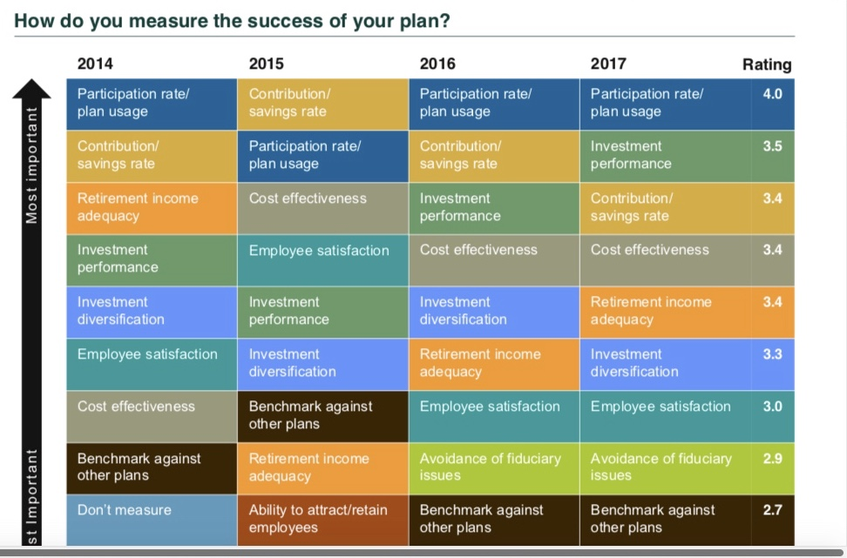
https://www.callan.com/wp-content/uploads/2018/01/Callan-2018-DC-Survey.pdf

Slide 22
CAMPAIGN THE PLAN
A. Provide annual review of the company 401k plan to the employees. Annual is minimum. 3 Legged Stool
* Discuss pension matching / SS Matching at this meeting
Employees DO NOT know about these matching payments
* Bring plan applications & payroll deduction forms.
B. Arrange for professional counseling. With the advisor or other qualified professional.

Slide 23
In 2018 , we gave our employees a 3% COLA increase and we packaged it as 2% in wage and 1% in 457 plan company match. ZERO match before 2018.

Slide 24
IMPROVE PARTICIPATION IN 401k
A. Implement an AUTO-ENROLL feature.
1. All new hires (onboarding) will be enrolled.
2. Employees must be given advanced notice.
3. Plan document specifies % of wages withheld.
4. Company match is required.
5. Allow total refund within 90 days.
6. Must choose QDIA = Qualified Default Investment Alternative (ex: Target-Dated Funds)
https://www.irs.gov/retirement-plans/plan-participant-employee/retirement-topics-automatic-enrollment

Slide 25
IMPROVE PARTICIPATION IN 401k (continued)
B. Implement auto-escalate.
C. Implement a zero waiting period. Start with 1st pay.
D. Create a 100% Vesting Policy.

Slide 26
CAMPAIGN IT & THEY WILL USE IT !
Payroll Deductions – Set it & Forget it
Target Dated Funds – Not Complicated
Perform the application process with them.
Reminder---- We are trying to help our employees get through retirement, not just to retirement.
Assist your employees to ROLLOVER their prior employer account balances in your plan.
25 / 41

Slide 27
VOYA 457 Plan summary
Scottsboro Trend Report for Past 9 years
YEAR End Balance Growth % Growth
12/31/2010 $282,574
12/31/2011 $323,709 $41,135 14.6%
12/31/2012 $433,819 $110,110 34.0%
12/31/2013 $579,930 $146,112 33.7%
12/31/2014 $758,697 $178,766 30.8%
12/31/2015 $856,009 $ 97,312 12.8%
12/31/2016 $1,000,734 $144,725 16.9%
12/31/2017 $1,166,404 $165,670 16.6%
12/31/2018 $1,220,940 $ 54,536 4.7%
$938,366 332.08%
This is in addition to our State of Alabama Pension Plan.
Growth includes employee contributions, dividends, & market appreciation.
Also includes exits such as retirees, terminations, and resignations.

Slide 28
In May 2019 , again we gave our employees a 3% COLA increase and we packaged it as 2% in wage and 1% in 457 plan company match.
Our employees really like the company match. We currently have 38 out of 41 participation.

Slide 29
Pay Raise versus 401(k) Employer Match
A pay raise compounds itself year over year
401(k)Employer Match does not have payroll overhead
1. Social Security/Medicare Match
2. Workers Compensation Insurance
3. General Liability Insurance

Slide 30
Pay Raise versus 401(k) Employer Match continued
c. The 401(k) employer match is:
1. Receiving Dividends
2. Beating inflation in capital appreciation
3. Tax deferred

Slide 31
Other information
RSA has a RSA-1 which is 457 and is promoted as free. With 2 options. No minimums. No company match. No ROTH option.
PERS has a stand-alone defined contribution plan and indicates the participants pay the fees, but the fees are not printed. A variety of funds to choose from. Has auto –escalating feature. It has a minimum of $300 per year contributions.

Slide 32
Teach Employees the FUNDAMENTALS
Understand the strategy of Traditional Plan versus ROTH.
Develop a Personal Investment Strategy for your account.
Become educated about your investment decisions
Time Horizon , Risk Tolerance, Investment Experience, Objective
Don’t pick funds based on your neighbor / co-worker.
Get professional help to maximize your gains.

Slide 33
WHAT DOES YOUR 401(K) PLAN LOOK LIKE?

